Slide 1
Meeting Report
Lily Leung 20170727

Slide 2
Lambert Beer’s Law
ln (I_{o}/I’)= nσl In NSRRC: I_{o}=I₁+I₂
I’=I₁’+I₂’, where I₂=I₂’
Hence, Detector detected:
ln(Io/I’)=n_{d} σl
Real: ln(I₁/I₁’)=n_{R} σl
I₂
I₁

Slide 3
Lambert Beer’s Law
Use aperture to block the extra IR light
Assume the intensity of the VUV beam is uniform
I₂
I₂
I₁
I₁’

Slide 4
Advised Beer’s Law - Production
I_{o}=I₁º+I₂º since I₁o=0.21/0.14 I₂º & I₁º=1.5I₂º
I’=I₁’+I₂’ since I₂º=I₂’ I’= I₁’+I₂º
Hence, I_{o}= 5/3 I₁º and I’=I₁’ + 2.5I_{o}
I₂
I₂
I₁
I₁’

Slide 5
Advised Beer’s Law- Production
Hence, I_{o}= 5/3 I₁º and I’=I₁’ + 2.5I_{o}
I₁º/I₁’=(3/5 Io )/ (I’-2/5I_{o})
Hence, we may use this to calculate upper limit.
I₂
I₂
I₁
I₁’

Slide 6
Advised Beer’s Law- Consumption
By getting R ln(I₁/I₁”) + (1-R)ln(I₂/I₂’) can get the real column Density of Reactant
R= 0.21/0.35 =0.6
The I₁/I₁” is (3/5 I )/ (I”-2/5 I’) from the previous deviation
Where I₂/I₂’ = (I/2.5)/(I’/2.5) = (I/I’)
Hence, Real Column Density = 0.6 * ln[(3/5 I )/ (I”-2/5 I’) ] +0.4*ln (I/I’)
I₂
I₂’
I₂’
I₁
I₁’
I₁”
I = I₁+I₂
I’ = I₁’+I₂’
I” = I₁”+I₂”

Slide 7
=LN((((3/5)*E3))/((E4-(2/5)*E3)))
 | integrating transmittance:
before depo | Io (E3) | 1788.799
270min | I’(E4) | 1787.115
 | abs afer correction | 0.00157
 | before correction | 0.000942
 | factor= | 1.66719

Slide 8
=LN((F10*(3/5))/(F12-F11/(2.5)))*0.6+LN(F10/F11)*0.4
 | maximum position | integration | subtracted intensity difference
Io (F10) | 17.72 | 4076.955 | 4076.95468
I (F11) | 15.313120000000 | 3895.097 | 3895.09674
I’(F12) | 16.27985 | 3946.073 | 3920.99502
abs(corrected) | 0.085700445 | 0.032685 | 0.039019418
abs(measured) | 0.084507864 | 0.032629 | 0.039004855
ratio | 1.014112066 | 1.00171 | 1.000373382

Slide 9
MDHL flux varies
Dose for 270min
RATIO | date | CH4+NH3 | AVERAGE | stdev | dev/average%
3:2 | 0405 | 8.58E+17 | 8.62E+17 | 1.56546E+16 | 1.82%
 | 0406 | 8.55E+17
 | 0410 | 8.42E+17
 | 0412 | 8.60E+17
 | 0414 | 8.71E+17
 | 0417 | 8.88E+17
1:5 | 0421 | 9.45E+17 | 9.48E+17 | 3.2532E+15 | 0.34%
 | 0424 | 9.48E+17
 | 0426 | 9.52E+17
1:10 | 0427 | 9.56E+17 | 9.57E+17 | 1.87705E+15 | 0.20%
 | 0428 | 9.56E+17
 | 0429 | 9.59E+17
1:20 | 0502 | 9.53E+17 | 9.53E+17 | 2.21133E+15 | 0.23%
 | 0503 | 9.52E+17
 | 0505 | 9.56E+17
450MIN | 0508 | 1.58E+18
 | 0510 | 1.57E+18
 |  | overall: | 9.17E+17 | 4.69536E+16 | 5.12%
RATIO | date | CH4+NH3+H2O | AVERAGE | stdev | dev/average%
1:5:5 | 0512 | 8.12E+17 | 8.20E+17 | 1.15258E+16 | 1.41%
 | 0515 | 8.28E+17
1:10:10 | 0518 | 8.23E+17 | 8.25E+17 | 3.11127E+15 | 0.38%
 | 0519 | 8.27E+17
5:3:4 | 0522 | 7.78E+17 | 7.85E+17 | 1.54124E+16 | 1.96%
 | 0524 | 7.75E+17
 | 0527 | 8.03E+17
 |  | overall: | 8.07E+17 | 2.23746E+16 | 2.77%
Difference between water added and without water
CH4+NH3 | CH4+NH3+H2O | ratio | %
9.17E+17 | 8.07E+17 | 1.14E+00 | 14.00%

Slide 10
NSRRC flux deviation
CH4+NH3+H2O | Date: | Au-mesh | Ni-Mesh dose | dev in Au | dev in Ni
 | 0713 | 2.07E-04 | 2.32E-04 | 0.55% | 2.71%
 | 0714 | 2.05E-04 | 2.25E-04
 | 0715 | 2.04E-04 | 2.20E-04
CH4+NH3 | 0707 | 2.04E-04 | 2.24E-04 | Ni-mesh value calculated by average of 0713 to 0715 factor
 | 0708 | 2.05E-04 | 2.25E-04
 | 0711 | 2.04E-04 | 2.69E-04 | 0.27% | 8.81%
 | 0712 | 2.04E-04 | 2.43E-04

Slide 14
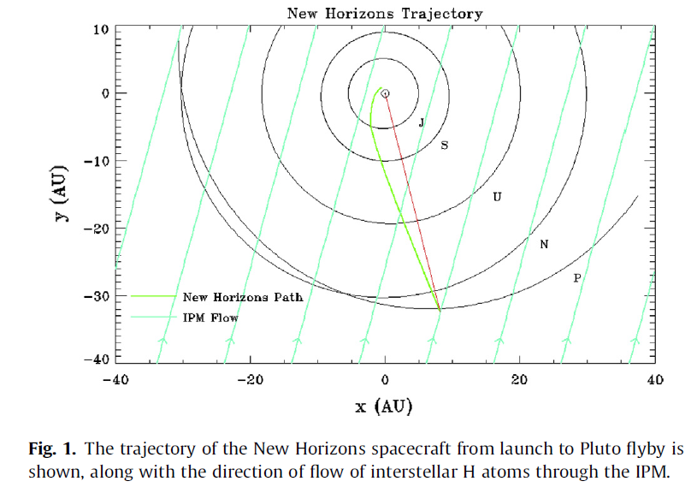
Report on Ly α @Pluto
Consist of 2 extinction:
Direct occulation from the sun (power: 70% onto pluto)
Emission of Ly α by IPM atomic hydrogen (power: 30% onto pluto)
Both are resonant scattered from part with light to the part without light by the hydrogen from pluto’s atmosphere
Gladstone et al. Icarus 246, 279 (2015)

Slide 15
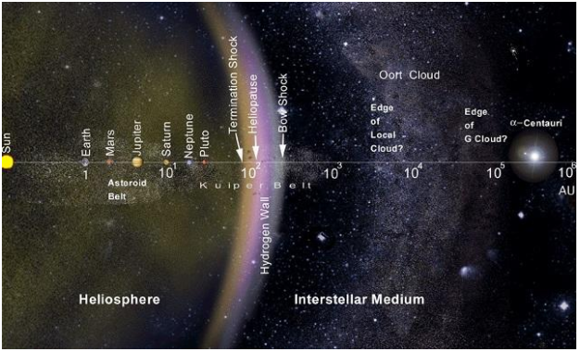
Comparable power : Direct occulation from sun reduce by 1/r² where IPM emission is throughout the solar system
39 A. U.
https://kknews.cc/science/en2lelr.html

Slide 16
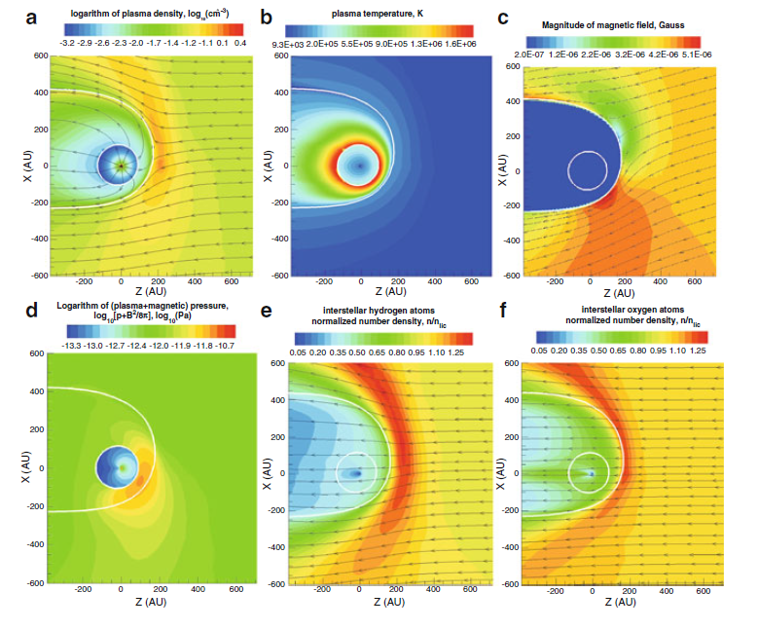
Solar wind plasma
having equal dynamic pressures (thermal & magnetic) forming termination shock
Exchange charge with neutral H He forming magnetic field
Magnetic field changes the flow direction of the hydrogen atoms but not oxygen atoms
Gladstone G.R., Stern S.A., Pryor W.R. (2013) New Horizons Cruise Observations of Lyman-α Emissions from the Interplanetary Medium. In: Quémerais E., Snow M., Bonnet RM. (eds) Cross-Calibration of Far UV Spectra of Solar System Objects and the Heliosphere. ISSI Scientific Report Series, vol 13. Springer, New York, NY

Slide 17
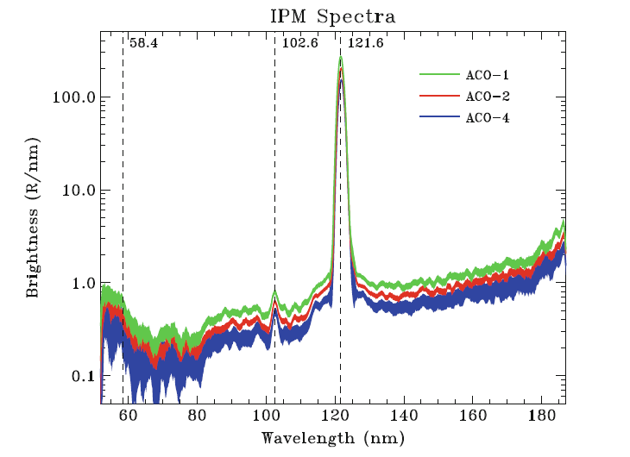
Corrected Emission from IPM
3 data obtaining night spectra by Alice camera.
At 7.6, 11.3, 17.0 AU
He I emission
Gladstone G.R., Stern S.A., Pryor W.R. (2013) New Horizons Cruise Observations of Lyman-α Emissions from the Interplanetary Medium. In: Quémerais E., Snow M., Bonnet RM. (eds) Cross-Calibration of Far UV Spectra of Solar System Objects and the Heliosphere. ISSI Scientific Report Series, vol 13. Springer, New York, NY

Slide 18
Paper:
Rarefied gas dynamic simulation of transfer and escape in the Pluto-charon system
William A. Hoey, Seng Keat Yeoh, Laurence M. Trafton, David B. Goldstein, Philip L. Varghese
Icarus 287, (2017) 87-102

Slide 19
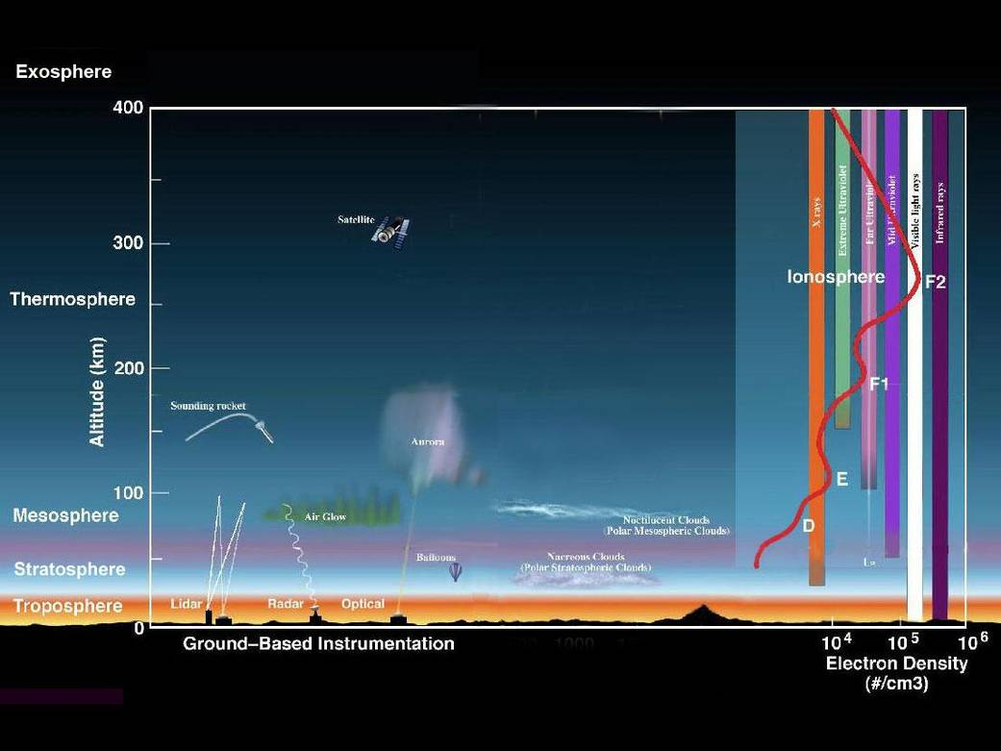
Paper Report: The CH₄ arrival on Charon by Pluto
Situation on Pluto
Earth Atm: Courtesy from NASA
Consider Above Exobase
T= 70 K cooling by HCN & C₂H₂
Exosphere: 42% of CH₄ dominates
1800 km from ground
N₂ dominated
Ice: N₂ dominated

Slide 20
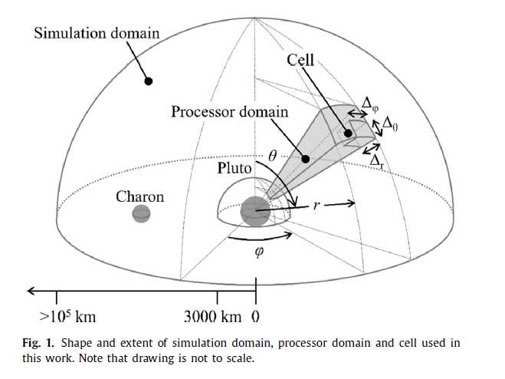
Modeling:
Different from Traditional hydrodynamic escape modelling, they use molecule by molecule Jeans process which is proven to be true.
Considered effects of Pluto’s rotation (gravitation field, centrifugal force & carioles force)
Gravitational field of Charon which perturbs Pluto’s exobase
Considered collisions altering flow field.
The model has employ a two-species model including methane
Investigated deposition of gas onto Charon

Slide 21
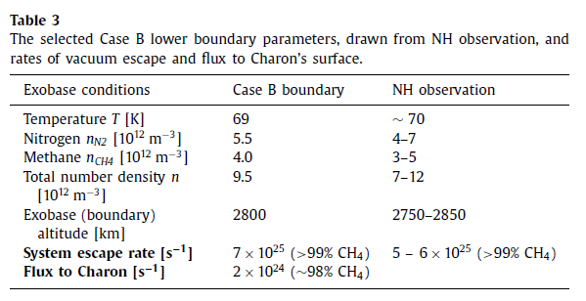
Assumption: Charon sink: All particles impact with charon stick onto charon
About 1.57 times larger than last week:
flux to charon:2x10²⁴ s⁻¹ =4.25 x10¹¹ m⁻² s⁻¹

Slide 22
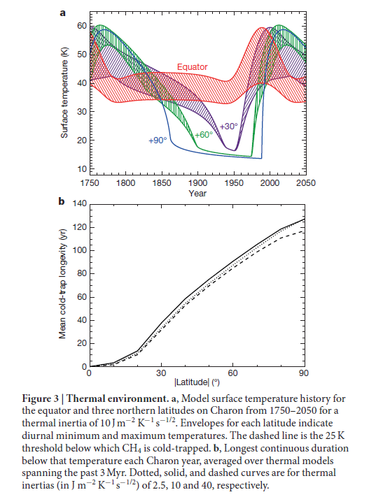
Recall last week:
130 years (2.7 x 10¹¹ molecules m⁻² s⁻¹)
Accumulated only 45º
If constant rate
110 ML deposited on pole
55 ML on 45º

Slide 23
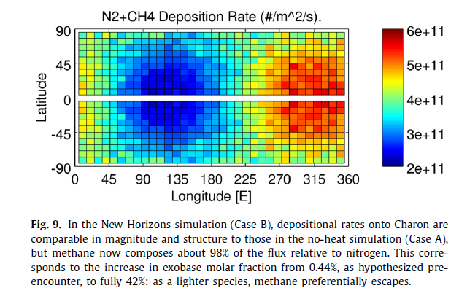
Hitting rates (assuming molecules do not move)
Facing Pluto

Slide 24
Conclusion
The ratios on Beam sizes are corrected by assuming VUV light and IR beam to be uniform.
The water added experiment has 14% lesser flux, which is larger than 5% deviation of MDHL flux
The flux depositing onto Charon is modelled by Hoey et al. (2017) and which is 1.57 larger than what Grundy et al. assumed.
Assumption has been made that Charon is the sink (molecules will not escape)
i.e. KE< KE(escape)

